Slide 1
AR FOOD MENU USING UNITY
MINI PROJECT IV
KESAVAN M(171CS184)

Slide 2
OBJECTIVE
The main objective of this Application is used to give an new experience to the customer who visiting the Hotels.

Slide 3
Problem Definition
This Application developed in order to make the people Fun and Entertainment. To replacing the Physical menu card to Android app with the Future technology of Augmented Reality.

Slide 4
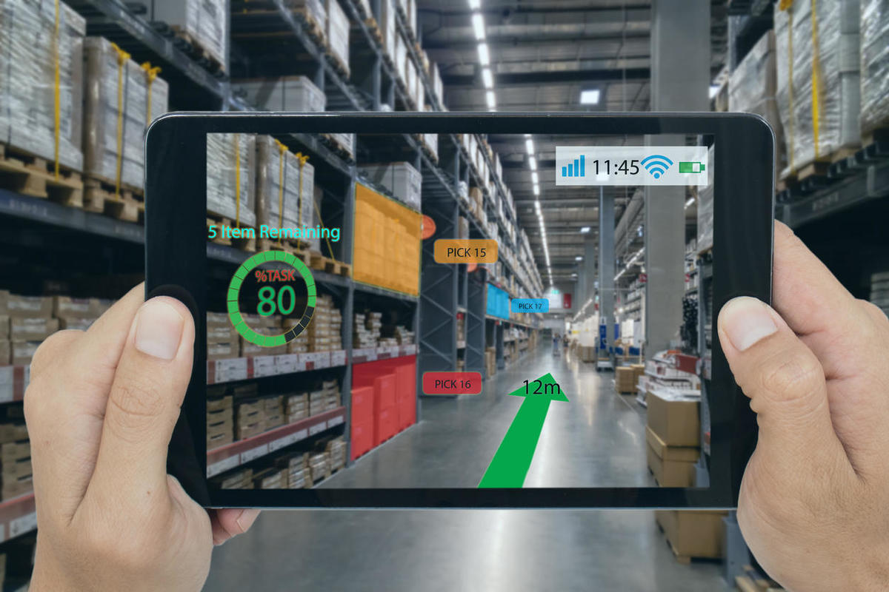
Augmented Reality Application
What is Augmented Reality?
Augmented reality is an interactive experience of a real-world environment where the objects that reside in the real world are enhanced by computer-generated perceptual information

Slide 5
Software Used :
Unity
Vuforia
Blender

Slide 6
Unity Game Engine
Used to create this AR Android application
Many desktop & android were created using this software
And also Augmented and Virtual reality were done by this software

Slide 7
Vuforia
augmented reality software development kit (SDK)
For Mobiles
recognize and track planar images and 3D objects in real time.

Slide 8
Blender
Free and Open source software.
Easy to develop the 3D objects
3D computer graphics software tool.

Slide 9
C Sharp Programming language
Object Oriented Programming language
Unity Supports C# language.
Part of .NET
Developing desktop Application and Android Application

Slide 10
CONCLUSION
Hence these are the requirements of the Augmented reality related applications and also our proposed methodology.

